Slide 1
Prudential Insurance Risk prediction
Ml foundation Term Project
By: Raj gupta (Aug cohort batch)

Slide 2
Problem statement
The goal is to develop a predictive model that accurately classifies risk using a more automated approach, which can greatly impact public perception of the insurance industry.
The results will help Prudential better understand the predictive power of the data points in the existing assessment, enabling them to significantly streamline the process.
We need to evaluate different ML algorithms and decide the best model for predicting the same.

Slide 3
Data collection
For this problem, dataset is provided by INSAID
In this dataset, we are provided over a hundred variables describing attributes of life insurance applicants
The task is to predict the "Response" variable for each Id in the test set. "Response" is an ordinal measure of risk that has 8 levels.

Slide 4
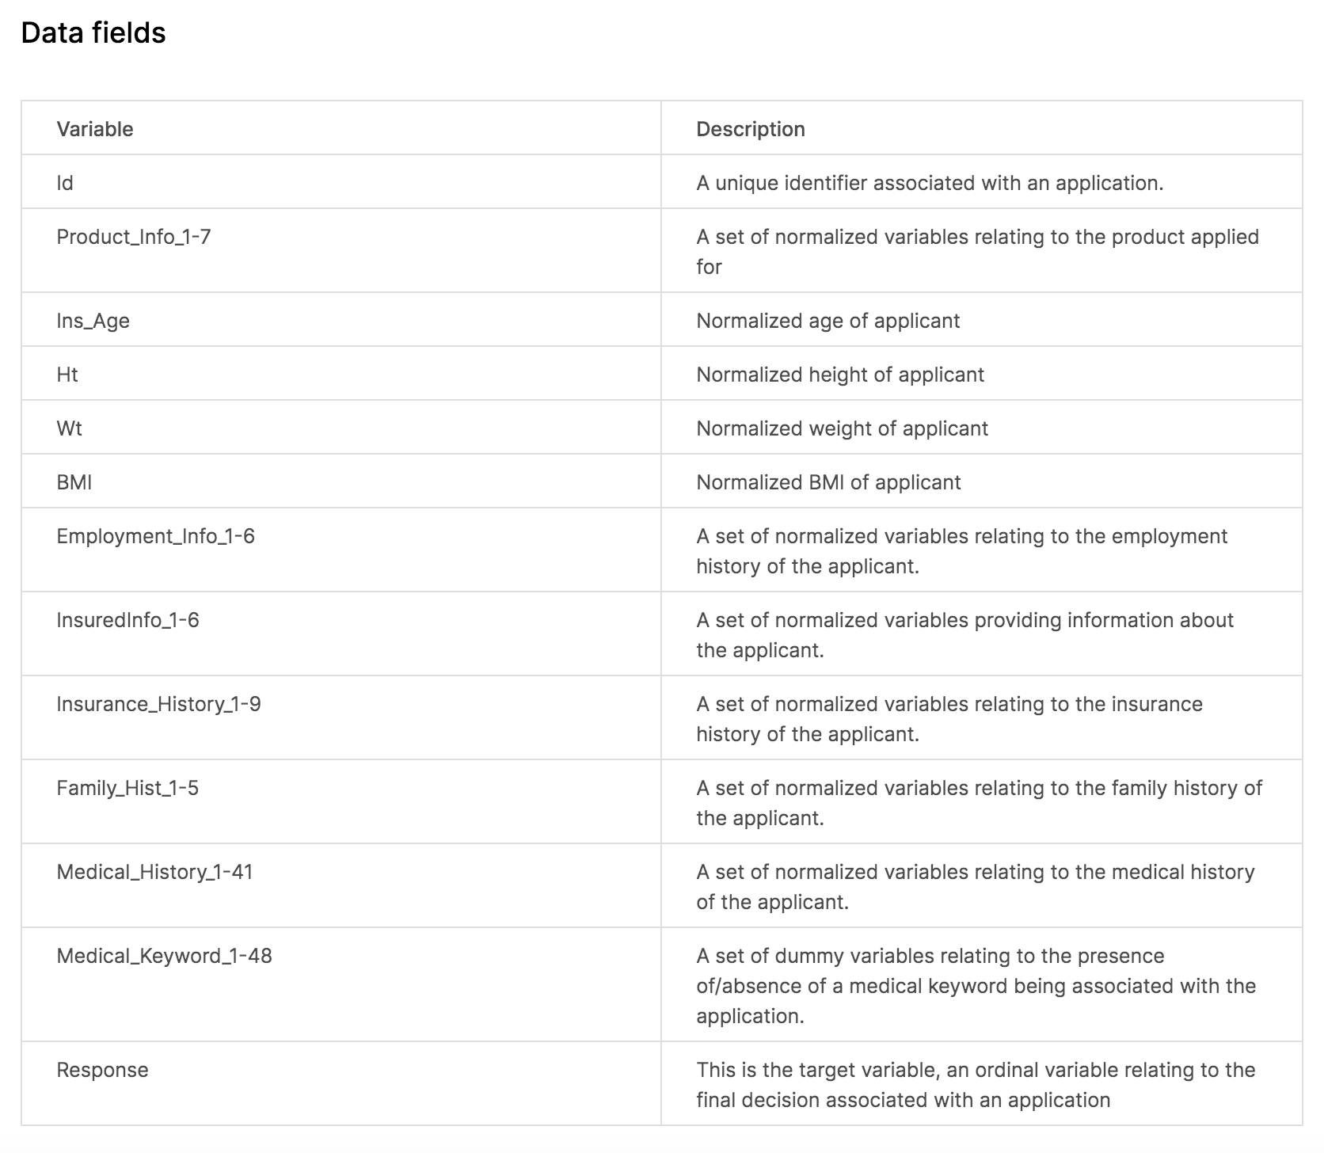
Data description

Slide 5
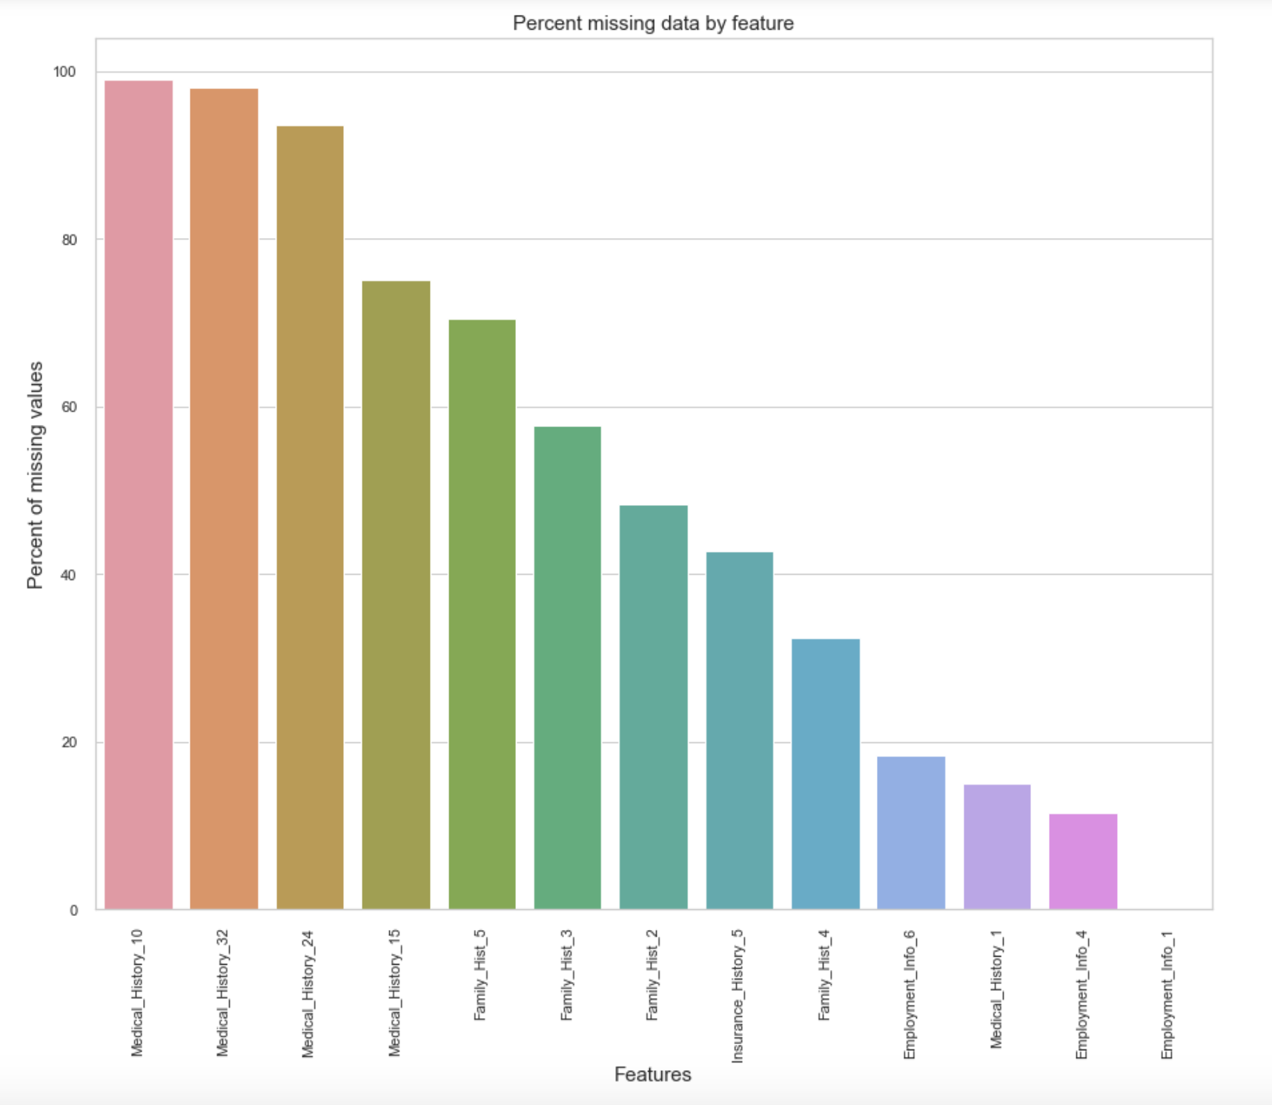
DATA CLEANING – missing data

Slide 6
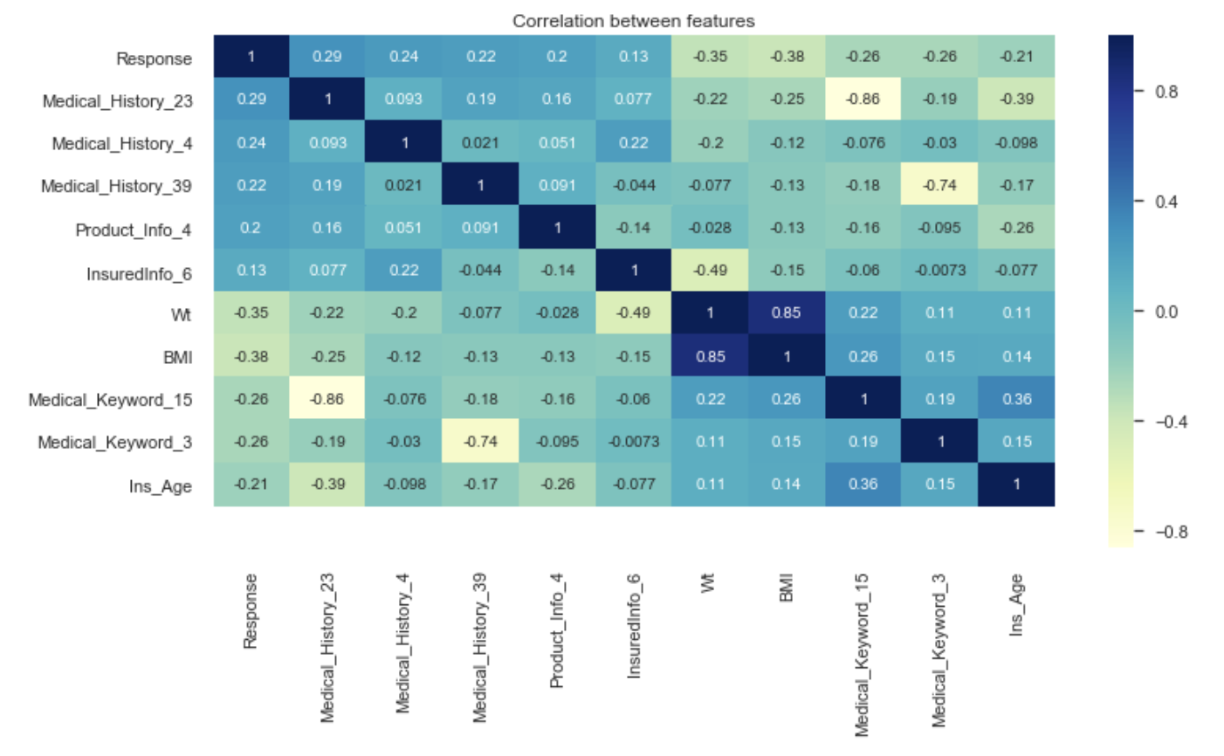
EDA – Feature selection - correlation

Slide 7
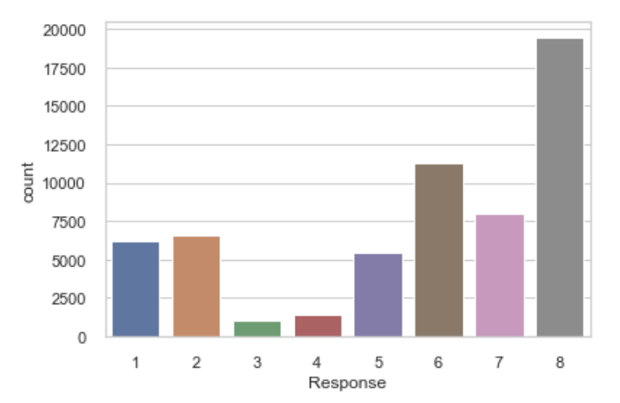
target variable - “Response”

Slide 8
model building
Since target variable is a Categorical variable with 8 classes, it is a classification problem.
ML algorithms used for model building are:
Logistic Regression
Decision Tree
Random Forest

Slide 9
Model evaluation
For a classification problem, we will evaluate the models based on:
Confusion Matrix
Accuracy Score
Precision
Sensitivity
F1 score
ROC_AUC Curve

